Slide 1

Encoder; Decoders
Computer Organization and Architecture | Introduction to Digital Fundamentals
Course: Computer Organization and Architecture | Chapter: Introduction to Digital Fundamentals | Program: Bachelor of Engineering
DISCOVER · LEARN · EMPOWER
Notes:
Welcome everyone to today's lecture on Encoders and Decoders. We are diving into the core of digital logic design within our Introduction to Digital Fundamentals chapter. Remember, these components are the translators of the digital world, converting signals between different formats. Let's begin our journey to understand how they function.

Slide 2
Course Outcomes
SLIDE 2 / 10
Course Outcome
CO | BT LEVEL | DESCRIPTION
CO1 | BT3 | Apply number systems and digital logic to design basic digital circuits
CO2 | BT4 | Analyze register organization and instruction set architecture
CO3 | BT3 | Implement computer arithmetic algorithms and floating-point operations
CO4 | BT5 | Analyze memory hierarchy and input-output organization
CO5 | BT6 | Evaluate control unit design and pipelining performance
Chandigarh University
2 / 10
Notes:
Today's session directly addresses Course Outcome 1. You will learn to apply digital logic principles to design circuits that convert binary inputs into specific outputs. This skill is fundamental for building complex systems like keyboards and seven-segment displays. By the end of this lecture, you will be able to design these basic circuits yourself.

Slide 3
Learning Objectives
SLIDE 3 / 10
Learning Outcomes
1
Define the fundamental function of an encoder in digital systems.
2
Analyze the working principle of a priority encoder with examples.
3
Explain the operation of a decoder as a demultiplexer.
4
Design basic 2-to-4 and 4-to-16 decoder circuits.
5
Differentiate between encoders and decoders based on input-output logic.
Chandigarh University
3 / 10
Notes:
By the end of this class, you will be able to define what an encoder does and how it differs from a decoder. We will analyze priority encoders, which handle multiple active inputs by selecting the highest priority one. You will also learn to design standard decoder circuits and understand their role in memory addressing. Finally, we will clearly differentiate the two components to avoid confusion in your designs.

Slide 4
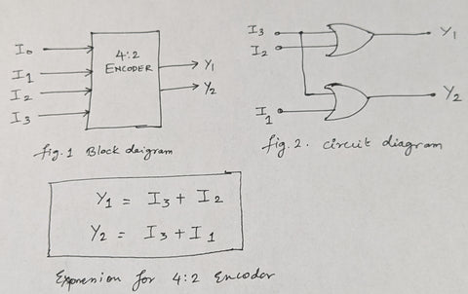
Lecture
SLIDE 4 / 10
Encoder Definition and Logic
1
An encoder converts multiple active input lines into a coded binary output.
2
It performs the reverse operation of a decoder in digital logic circuits.
3
A standard n-to-m encoder has 2^n inputs and m output lines.
4
Only one input line is assumed to be active high at a time.
5
The output represents the binary code of the active input position.
What is a Binary Encoder? Know 4-to-2 Binary Encoder
Chandigarh University
4 / 10
Notes:
Think of an encoder as a translator that takes a specific signal and turns it into a binary number. For example, if you press the '5' key on a keyboard, the encoder converts that single active line into the binary code 0101. It is crucial to remember that standard encoders assume only one input is active at any given moment. If multiple inputs are active, the output becomes ambiguous without special handling.

Slide 5
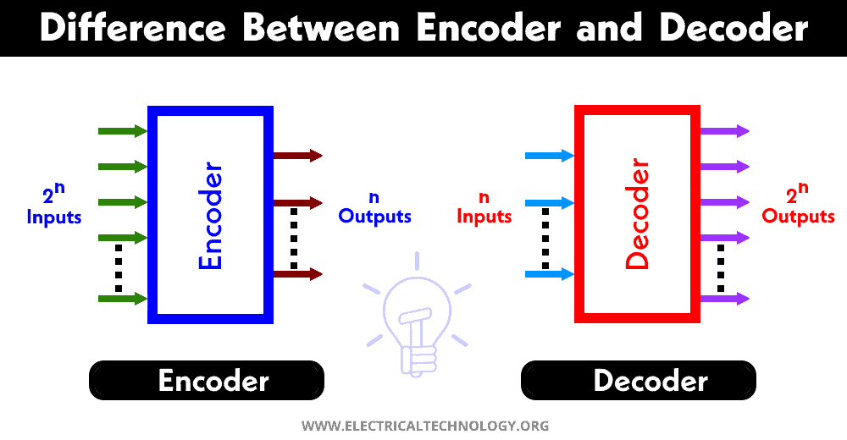
Lecture
SLIDE 5 / 10
Priority Encoder Operation
1
A priority encoder resolves conflicts when multiple inputs are active simultaneously.
2
It assigns a priority level to each input line based on significance.
3
The output reflects the binary code of the highest priority active input.
4
A valid output bit indicates whether any input line is currently active.
5
Common applications include keyboard scanning and interrupt handling in processors.
What is the Differences Between Encoder and Decoder? (source: www.electricaltechnology.org)
Chandigarh University
5 / 10
Notes:
In real-world scenarios, multiple buttons might be pressed at once, causing a conflict for a standard encoder. A priority encoder solves this by assigning a hierarchy, where the highest numbered input takes precedence. For instance, if inputs 3 and 1 are both high, the output will represent 3, ignoring input 1. This feature is vital for interrupt controllers where urgent signals must be processed first.

Slide 6
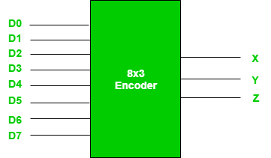
Lecture
SLIDE 6 / 10
Decoder Definition and Logic
1
A decoder converts a binary input code into a specific active output line.
2
It has m input lines and 2^m output lines representing all combinations.
3
Only one output line is active high for a given binary input.
4
Decoders act as demultiplexers by routing a single input to one output.
5
They are essential for memory address decoding and display driving.
Encoders and Decoders in Digital Logic - GeeksforGeeks (source: media.geeksforgeeks.org)
Chandigarh University
6 / 10
Notes:
If an encoder is a translator, a decoder is a distributor that takes a binary address and activates a specific line. Imagine a 2-to-4 decoder where input 10 activates the third output line, effectively selecting a specific memory location. This component is the backbone of memory systems, allowing the CPU to access specific bytes. It essentially translates the binary address into a physical selection signal.

Slide 7
Lecture
SLIDE 7 / 10
Decoder as Demultiplexer
1
A decoder functions as a demultiplexer when an enable input is used.
2
The binary input selects which output line receives the data signal.
3
The enable line acts as the data input to be distributed.
4
This configuration allows one data source to reach multiple destinations.
5
It is widely used in data routing and communication systems.
What is the Differences Between Encoder and Decoder? (source: www.electricaltechnology.org)
Chandigarh University
7 / 10
Notes:
You can repurpose a decoder to act as a demultiplexer by using its enable pin as the data input. When the enable is active, the binary input selects exactly one output line to pass the data through. This is like a train switch that directs a single train to one of several tracks based on the switch position. This flexibility makes decoders incredibly useful in complex data routing applications.

Slide 8
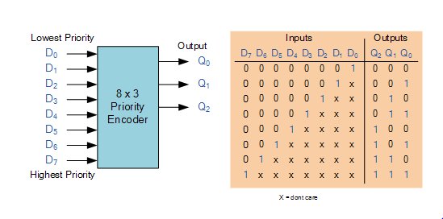
Worked Example
SLIDE 8 / 10
2-to-4 Decoder
1
For a 2-to-4 decoder, inputs A1 and A0 determine the active output.
2
Input 00 activates output Y0, while 01 activates output Y1.
3
Input 10 activates output Y2, and 11 activates output Y3.
4
The logic equation for Y2 is A1 AND (NOT A0).
5
This circuit selects one of four memory blocks based on the address.
Encoders & Decoders - STUDYTRONICS (source: studytronics.weebly.com)
Chandigarh University
8 / 10
Notes:
Let's look at a concrete example of a 2-to-4 decoder. If the inputs are 1 and 0, the output Y2 becomes high, while all others remain low. The logic equation for Y2 is simply A1 AND NOT A0, which you can implement with basic gates. This specific configuration is often used to select one of four memory chips in a computer system. Understanding this mapping is key to designing address decoding logic.

Slide 9
Lecture
SLIDE 9 / 10
Key Takeaways
1
Encoders convert multiple inputs into a binary code representing the active line.
2
Priority encoders handle multiple active inputs by selecting the highest priority.
3
Decoders convert binary codes into specific active output lines for selection.
4
Decoders can function as demultiplexers to route data to specific destinations.
5
Both components are fundamental for memory addressing and input processing.
Encoders & Decoders - STUDYTRONICS (source: studytronics.weebly.com)
Chandigarh University
9 / 10
Notes:
To summarize, encoders compress information by converting active lines into binary codes, while decoders expand binary codes into specific active lines. Remember that priority encoders are essential when multiple inputs might be active simultaneously. Decoders are versatile and can serve as demultiplexers for data routing. Mastering these two components is crucial for your ability to design digital circuits effectively.

Slide 10
Lecture
SLIDE 10 / 10
References
COMPUTER ORGANIZATION AND DESIGN
The Hardware/Software Interface — David A. Patterson, John L. Hennessy
COMPUTER ARCHITECTURE
A Quantitative Approach — John L. Hennessy, David A. Patterson
• Computer Organization and Architecture — William Stallings
• Computer System Architecture — M. Morris Mano & Rajib Mall
• Computer Organization — Carl Hamacher, Zvonko Vranesic, Safwat Zaky
Chandigarh University
10 / 10
Notes:
For further reading and deeper understanding, please refer to the standard textbooks listed on this slide. William Stallings and M. Morris Mano provide excellent foundational knowledge on these topics. David A. Patterson's works offer a modern perspective on hardware-software interfaces. I encourage you to consult these resources to reinforce the concepts we discussed today.

